Slide 1
Selection Sort
2023/02/18
Hailey

Slide 2
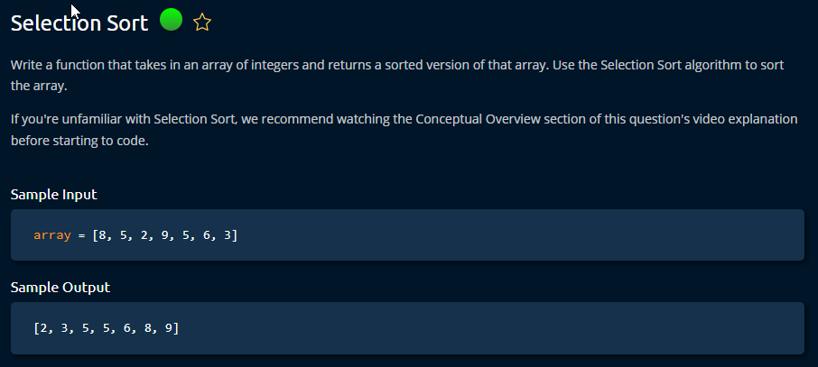

Slide 3
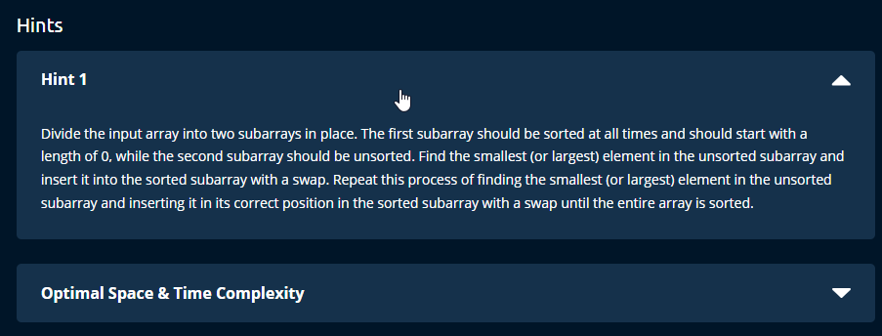

Slide 4
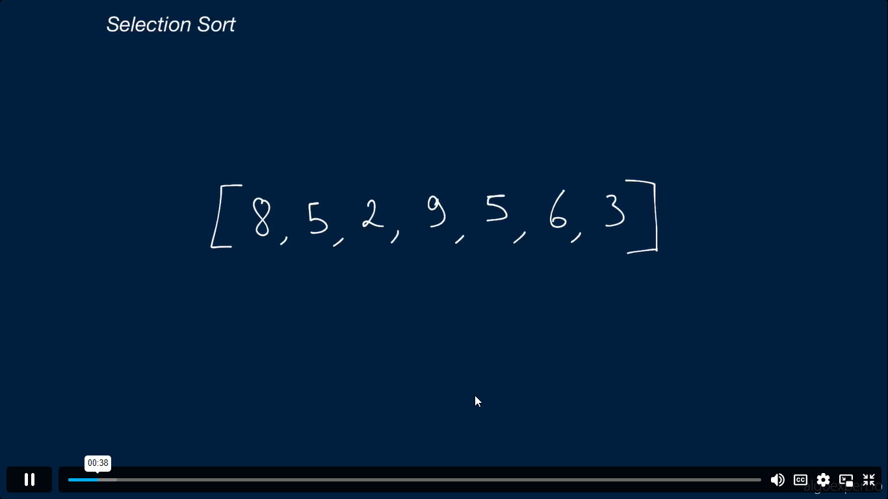

Slide 5
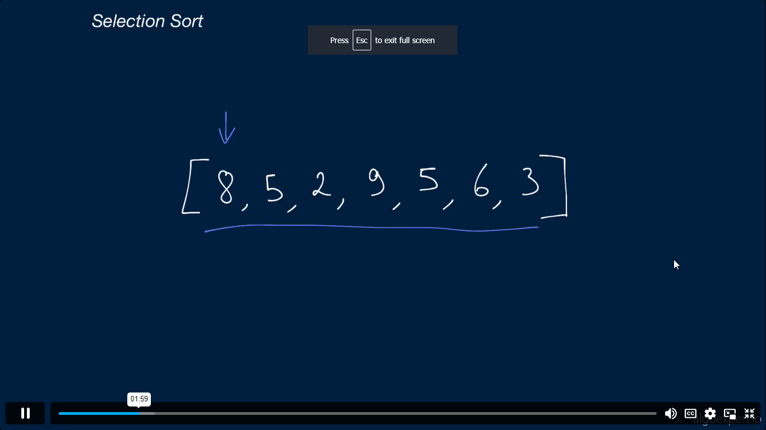

Slide 6
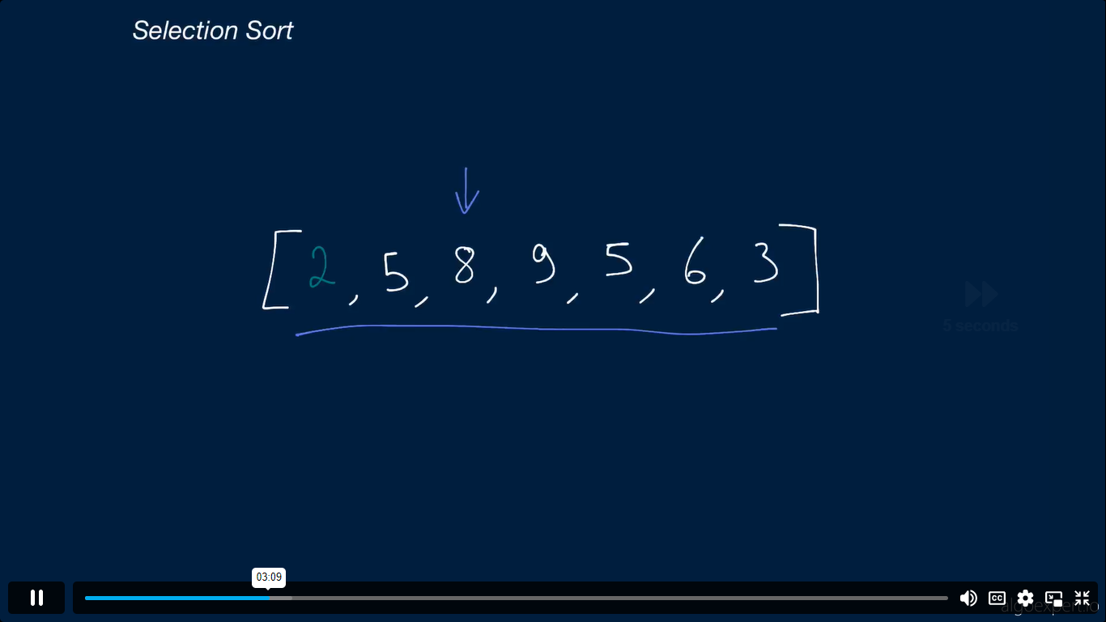

Slide 7
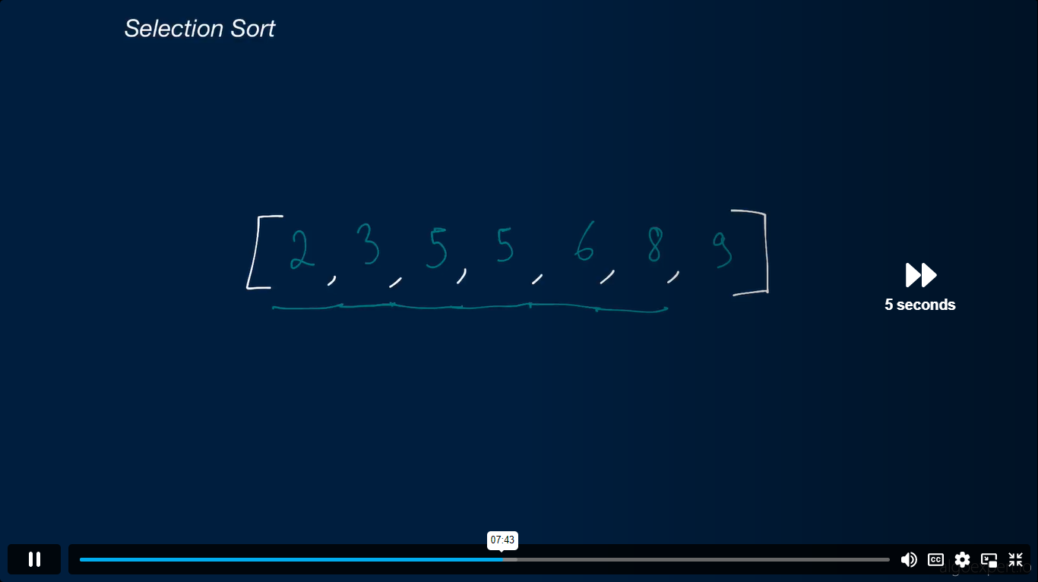

Slide 8
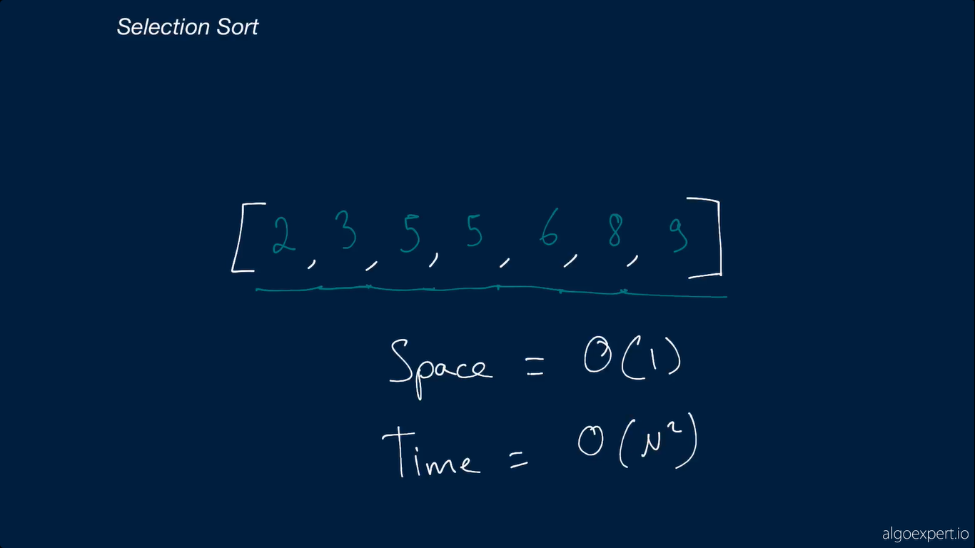

Slide 10
Steps
Find the smallest number form the list.
Swap in with the first index.
Repeat the same process until the array reaches the end.
Time = O(n*2)
Use both for and while loop
Space = O (1)

